Slide 1
Driving the Culture Change:
Lawyer Well-Being is More than a Fad
Notes:
Lindsey

Slide 2
Agenda
The Movement began with an idea – and a need
Intersection with client protection
Institute for Well-Being in Law (IWIL)
Future directions
Notes:
Lindsey

Slide 3
The Idea and Need
The initial reports
The ABA and other institutional support
The National Task Force and its Report
Notes:
Lindsey

Slide 4
Beginning of the Well-Being in Law Movement - 2016
The Prevalence of Substance Use and Other Mental Health Concerns Among American Attorneys (the “Lawyer Study”)
P.R. Krill, R. Johnson, & L. Albert
10 J. Addiction Med. 46 (2016)
Suffering in Silence: The Survey of Law Student Well-Being and the Reluctance of Law Students to Seek Help for Substance Use and Mental Health Concerns (the “Law Student Survey”)
J.M. Organ, D. Jaffe, K. Bender
66 J. Legal Educ. 116 (2016)
Notes:
Jennifer

Slide 5
THE AMERICAN BAR ASSOCIATION (ABA) MADE SIGNIGICANT CONTRIBUTIONS TO THE EARLY EFFORT…
Several entities associated with the American Bar Association played major roles in the work of the National Task Force on Lawyer Well-Being. Represented on the Task Force were the ABA
Commission on Lawyer Assistance Programs
Standing Committee on Professionalism
Center for Professional Responsibility
Young Lawyers Division
Law Practice Division Attorney Wellbeing Committee
Notes:
Jennifer

Slide 6
ADDITIONAL ORGANIZATIONS PARTICIPATED…
In addition to ABA entities, the original Task force included representation from the
National Organization of Bar Counsel
Association of Professional Responsibility Lawyers
National Conference of Chief Justices
National Conference of Bar Examiners
Notes:
Jennifer

Slide 7
Who is the National Task Force on Lawyer Well-Being? (now IWIL)
National Organizations Outside the ABA
Conference of Chief Justices
National Conference of Bar Examiners
National Organization of Bar Counsel
Association of Professional Responsibility Lawyers
National Client Protection Organization
National Conference of Lawyer Disciplinary Boards
The National Judicial College
National Association of Law Student Affairs Professionals
Entities Inside the ABA
Commission on Lawyer Assistance Programs
Standing Committee on Professionalism
Center for Professional Responsibility
Young Lawyers Division
Law Practice Division Attorney Wellbeing Committee
Individuals
Malpractice Carriers
Global Law Firms
Authors of studies that served as catalyst for the Task Force
www.lawyerwellbeing.net
Notes:
Jennifer

Slide 8
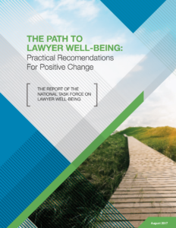
THE REPORT…
In 2017, the Task Force issued the report that is the anchor for the movement and effort for culture change…
Notes:
Jennifer

Slide 9
About “Well-Being”
Well-Being is about:
PREVENTION of impairments (substance abuse, mental health problems), and
TREATING impairments when they occur, and
PREVENTION of their relapse
AND it’s about a continuous process of thriving across multiple dimensions…
Notes:
Jennifer

Slide 10
Intersection with Client Protection
“A good lawyer is a healthy lawyer”
More than just substance abuse
Prevention/reduction of claims
Notes:
Lindsey

Slide 11
THE NEED…
Each of our Funds paid claims resulting from acts of attorneys whose practices suffered due to substance abuse impairment, mental health complications, unaddressed stress, etc. The 2016 study of attorneys indicated
between 21 and 36 percent qualify as problem drinkers
approximately 28 percent are struggling with some level of depression
approximately 19 percent are struggling with some level of anxiety
approximately 23 percent are struggling with some level of stress
Notes:
Lindsey

Slide 12
ABA MODEL RULE 1:1 COMPETENCE
“A lawyer shall provide competent representation to a client. Competent representation requires the legal knowledge, skill, thoroughness and preparation reasonably necessary for the representation.”
And from the Task Force Report…
“To be a good lawyer, one has to be a healthy lawyer.”
Notes:
Lindsey

Slide 13
THE PRACTICAL RESULTS…
Cited in the Task Force Report were
At least one author suggests that 40 to 70 percent of disciplinary proceedings and malpractice claims against lawyers involve substance use or depression, and often both.
Major depression is associated with impaired executive functioning, including diminished memory, attention, and problem-solving.
(In instances of alcohol abuse), deficits are particularly severe in executive functions, especially in problem-solving, abstraction, planning, organizing, and working memory— core features of competent lawyering.
Notes:
Lindsey

Slide 14
MODEL RULES FOR LAWYERS’ FUNDS FOR CLIENT PROTECTION – RULE 10 ELIGIBLE CLAIMS
The loss must be caused by the dishonest conduct of the lawyer and shall have arisen out of and by reason of a client-lawyer relationship or a fiduciary relationship between the lawyer and the claimant.
C. As used in these Rules, "dishonest conduct" means wrongful acts committed by a lawyer in the nature of theft or embezzlement of money or the wrongful taking or conversion of money, property or other things of value, including but not limited to: (1) Failure to refund unearned fees received in advance…
Notes:
Lindsey

Slide 15
NOT TO BE IGNORED…
Gambling addiction is known as a ”process disorder.”
Problem gambling (may) go hand in hand with drugs and alcohol and result in devastating results to
legal careers
personal lives
families
Notes:
Lindsey

Slide 16
AMONG THE CORE STEPS THE TASK FORCE REPORT IDENTIFIED TO BUILD A MORE SUSTAINABLE CULTURE…
(3) Emphasizing that well-being is an indispensable part of a lawyer’s duty of competence. Among the report’s recommendations are steps stakeholders can take to highlight the tie-in between competence and well-being.
Notes:
Lindsey

Slide 17
FOLLOWING THE RELEASE OF THE REPORT…
In the years since the release of the report, the message of Lawyer Well-Being has spread throughout the profession and associated stakeholders. The National Task Force continued to meet – and in fact expanded from its original membership –and assisted
The development of State Task Forces across the nation
In conversations with Supreme Court Chief Justices and other Bar Association leadership entities
Outreach to allied stakeholder entities including Affinity Bars and developed strategies to create a sustainable movement and consistent message
Notes:
Lindsey

Slide 18
AN IMAGE SEEN THROUGHOUT THE LEGAL COMMUNITY…
Notes:
Lindsey

Slide 19
Institute for Well-Being in Law
Who We Are
A thinktank dedicated to the betterment of the legal profession by focusing on a holistic approach to promoting well-being and addressing behavioral health disorders.
Our mission: Through advocacy, research, education, technical and resources support, and stakeholders’ partnerships, IWIL is driven to lead a culture shift in law to establish health and well-being as core centerpieces of professional success.
What We Do
Biennial Conference
Annual Well-Being Week in Law
Thought Leader Policy Roundtables
State Well-Being in Law Task Force Support
Research & Advocacy
Monthly Publication of IWIL Alert
Quarterly Publication of The Catalyst
www.lawyerwellbeing.net
Notes:
Jennifer

Slide 20
Behavioral Health of the Legal Profession Post-Pandemic
30% lawyers experiencing hazardous drinking (up 50% since 2016)
Numerous studies showing rate of burnout at approx. 50%
1 in 4 women are contemplating leaving the legal profession due to mental health, burnout, stress (17% of men)
Notes:
Jennifer
Stress Drink Leave Study – Patrick Krill
ABA Practice Forward Study
ALM Study
People Professions and Profit Centers – Patrick Krill – April 2022

Slide 21
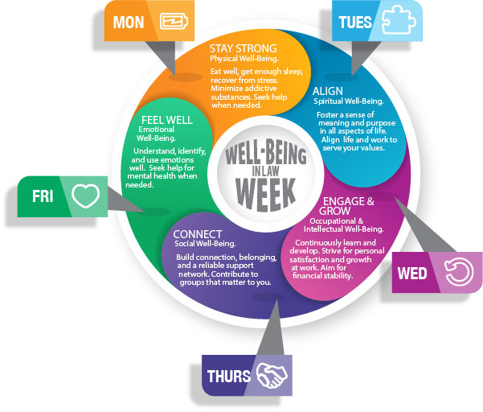
SINCE IWIL WAS FOUNDED…
Building on the decision stated in the Report to emphasize well-being as opposed to “wellness” or “health,” IWIL has worked to institutionalize and spread the well-being movement through, among other efforts,
Two annual observances of Well-Being in Law Week that coincide with Mental Health Awareness Month (May)
A virtual conference (January 2022) that brought together practitioners and other profession stakeholders for a multi-day discussion of well-being related topics
Creation of podcasts and newsletters highlighting topics of interest to the legal community
Notes:
Jennifer

Slide 22
Institute for Well-Being in Law (IWIL)
Clarifying the message
Identifying the stakeholders
Building coalitions
Spreading the word
Notes:
Jennifer

Slide 23
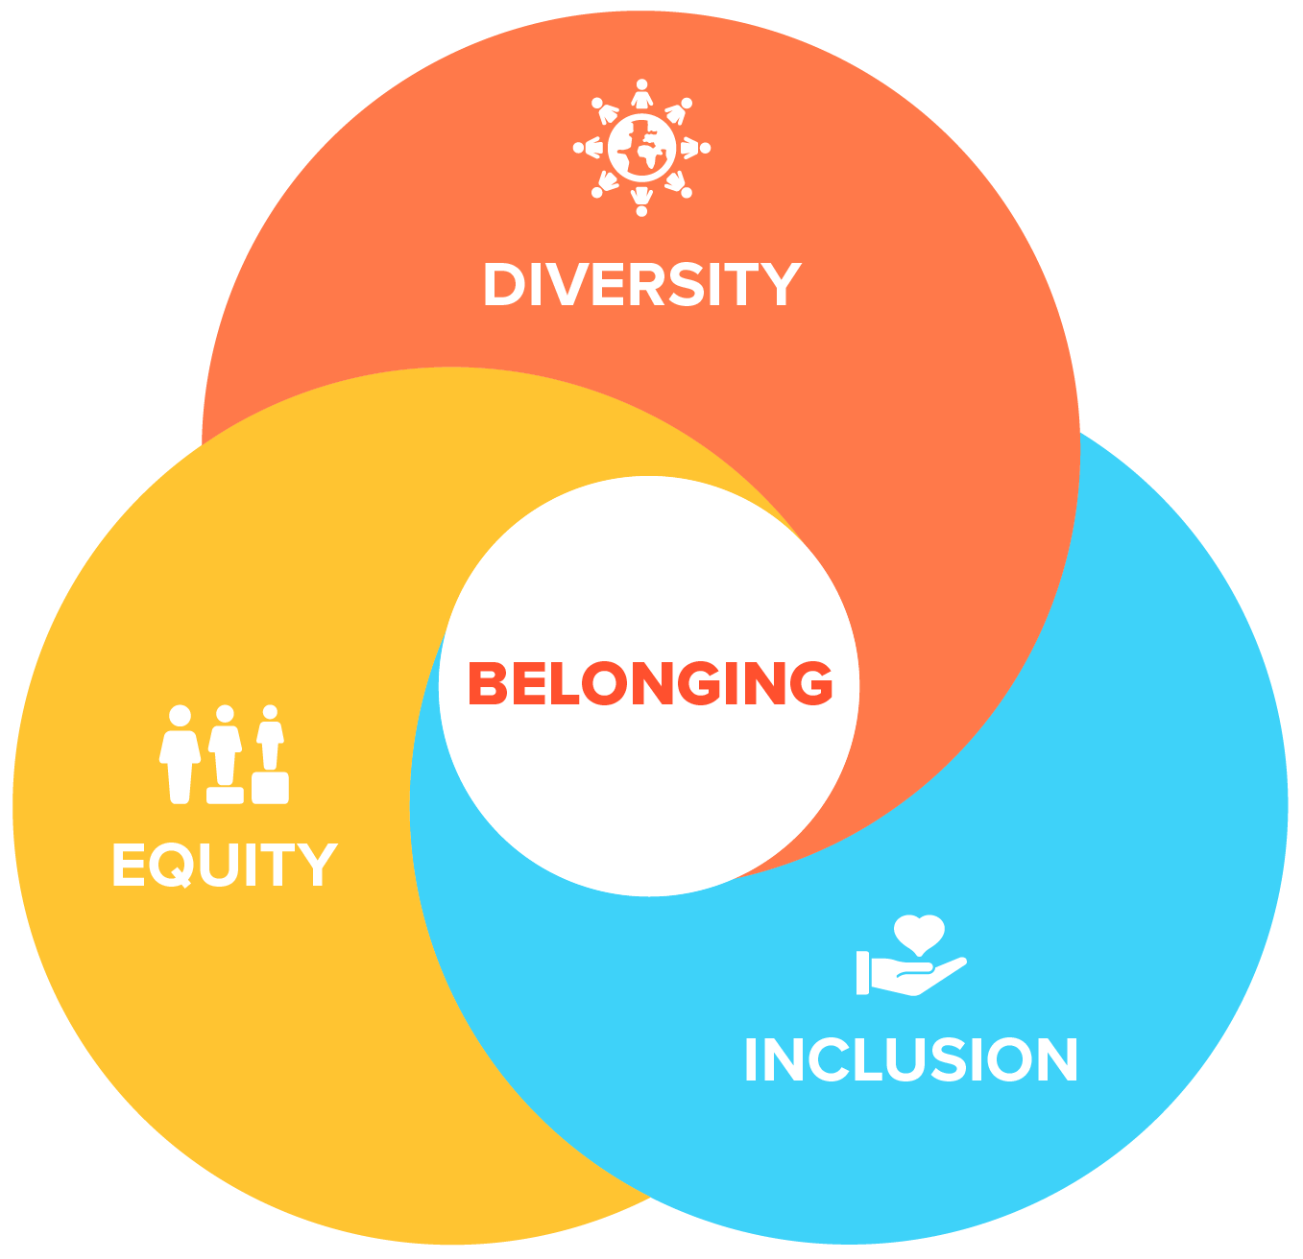
DIVERSITY, EQUITY AND INCLUSION POLICY
At the time of its founding, IWIL stated a recognition that underrepresented populations in the legal profession had additional well-being consideration.
“The profession must recognize, however, that populations that are underrepresented in the ranks of law students, attorneys, and judges have historically
faced countless barriers to entry into the legal ranks;
confronted structural challenges to success; and
been forced to navigate daily micro- and macro-aggressions regarding their identities in the legal profession that are not faced by those outside these groups.
Each of these barriers, challenges, and slights enhance stress, takes a toll on their individual and collective well-being, and creates a hostile landscape that threatens self-esteem and increases the potential for burnout.”
Notes:
Lindsey

Slide 24
Questions
Notes:
Lindsey

Slide 25
CONTACT
Jennifer DiSanza Executive Director Institute for Well-Being In Law jdisanza@lawyerwellbeing.net
Lindsey Draper Vice President for Diversity, Equity and Inclusion Institute for Well-Being in Law lindrap@prodigy.net

