Slide 1
WELCOME 2022 National Client Protection Organization Workshop September 19, 2022 Lexington, Kentucky

Slide 2
Welcoming Remarks

Slide 3
TOWN HALL
What’s happening in
YOUR State
or Province:

Slide 4
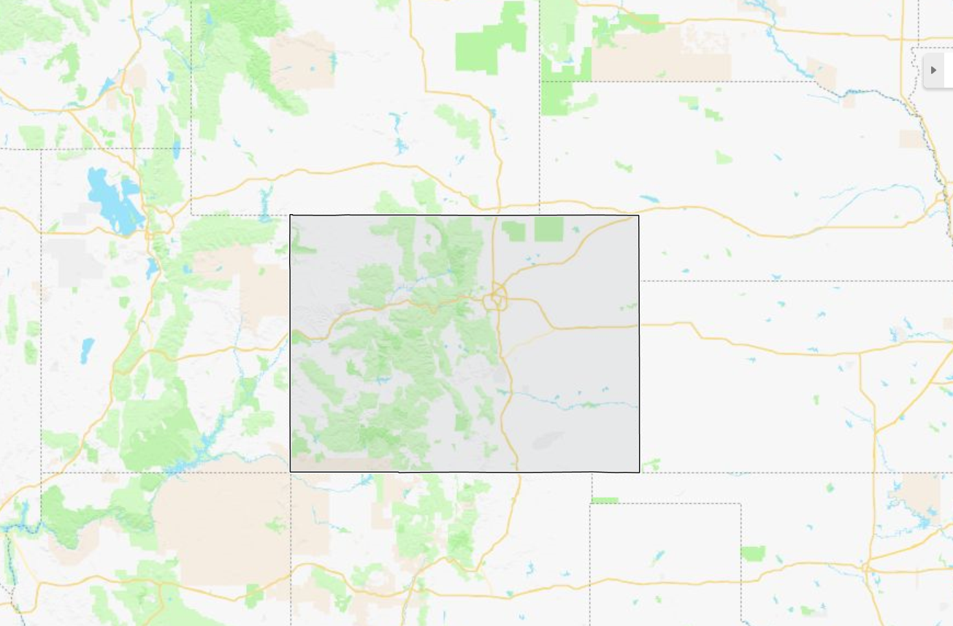
Colorado The Centennial State
Approx. 24,000 licensed attorneys
Attorney’s Fund for Client Protection established in 1998
Here’s what’s
happening:

Slide 5
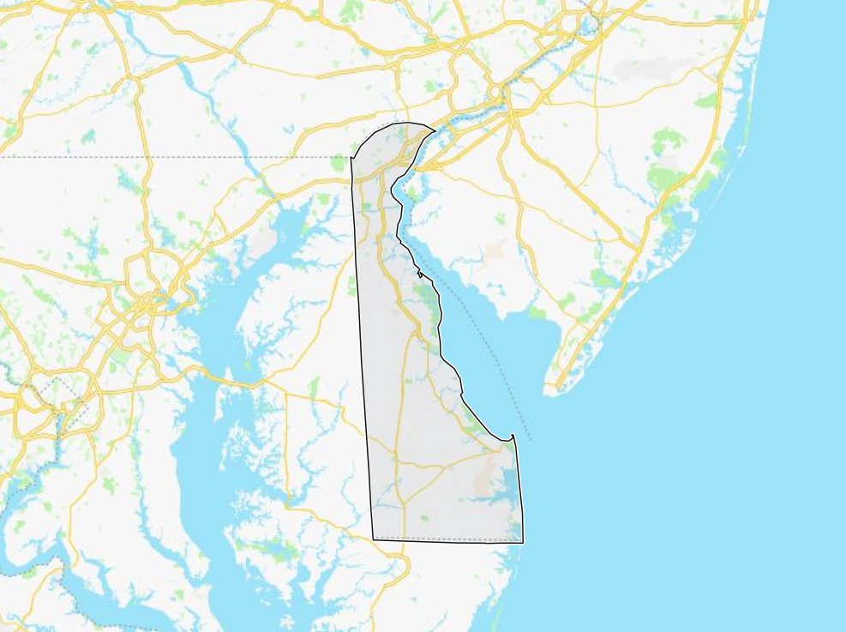
Delaware The First State
Approx. 3,600 licensed attorneys
Lawyers’ Fund for Client Protection established in 1968
Here’s what’s
happening:

Slide 6
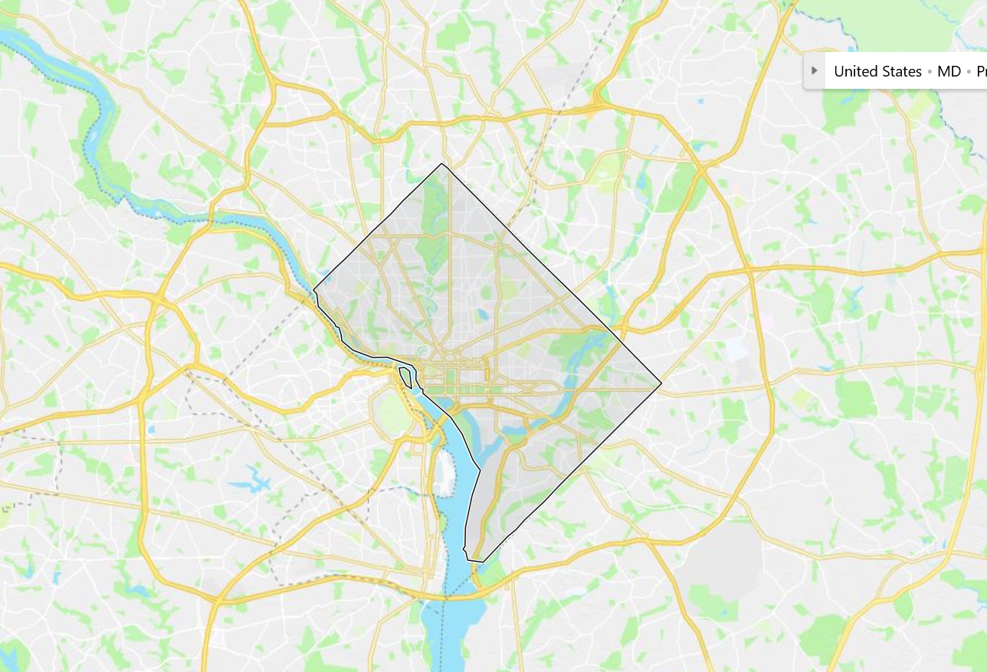
District of Columbia The Federal City
Approx. 100,000 licensed attorneys
Clients’ Security Fund established in 1972
Here’s what’s
happening:

Slide 7
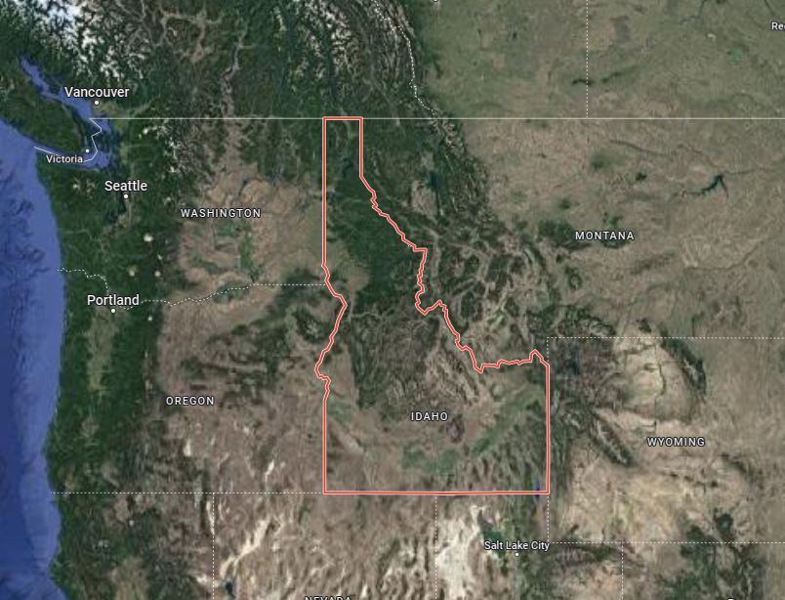
Idaho The Gem State
Approx. 6,000 licensed attorneys
Client Assistance Fund established in 1969
Here’s what’s
happening:

Slide 8
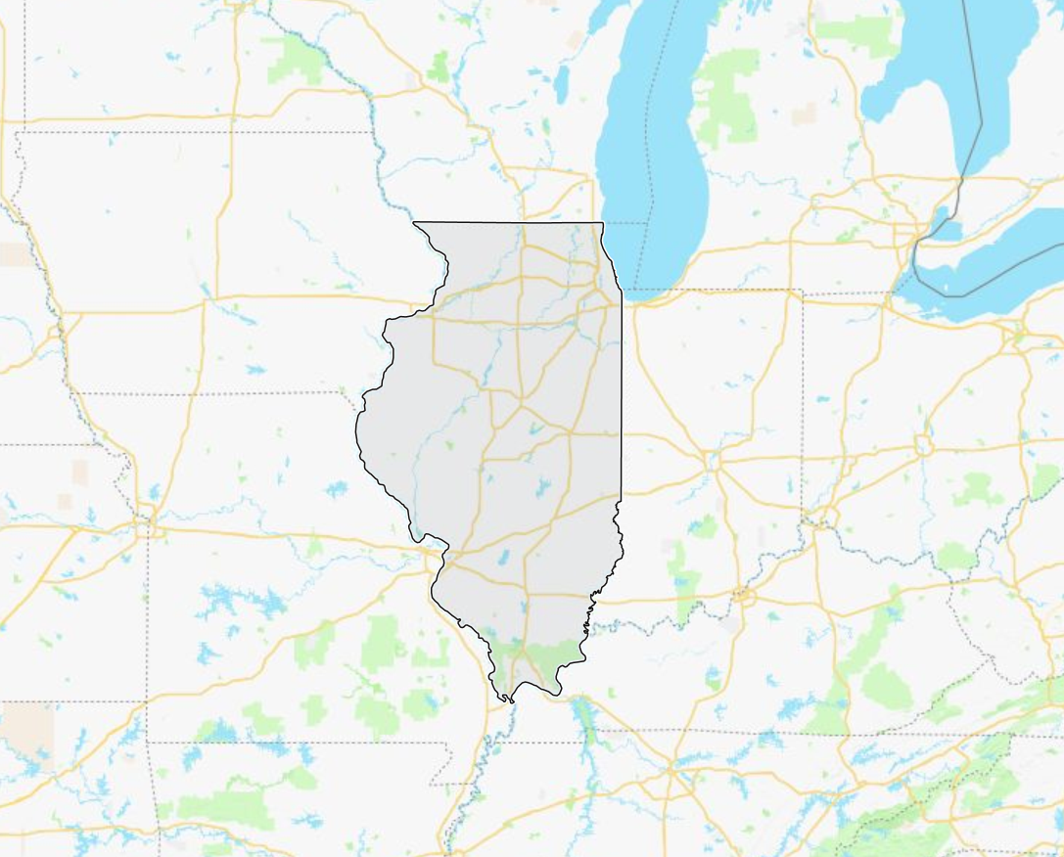
Illinois The Prairie State
Approx. 95,000 licensed attorneys
Client Protection Program established in 1994
Here’s what’s
happening:

Slide 9
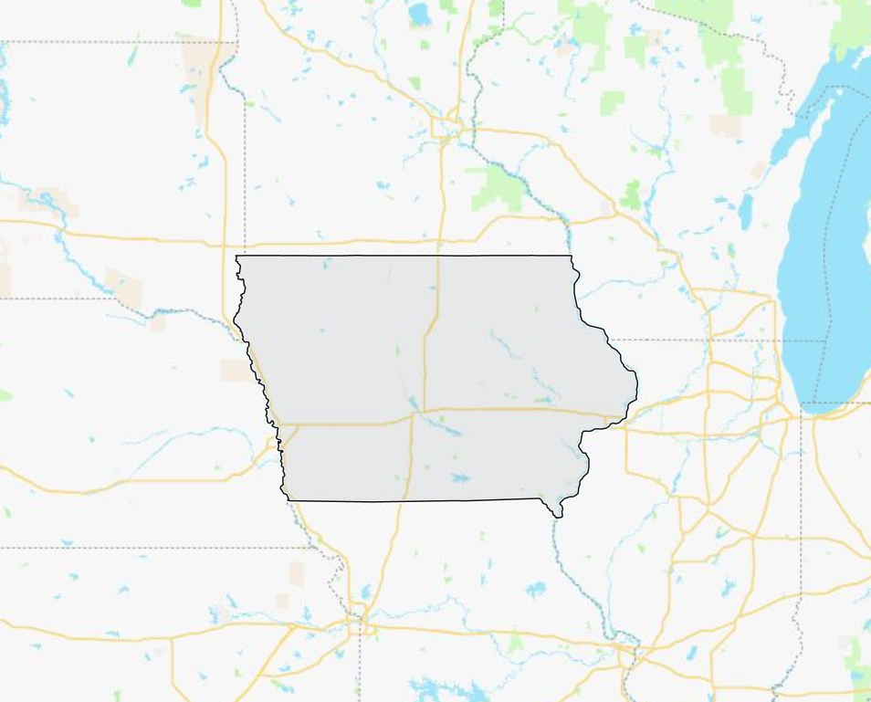
Iowa The Hawkeye State
Approx. 10,000 licensed attorneys
Client Security Trust Fund established in 1974
Here’s what’s
happening:

Slide 10
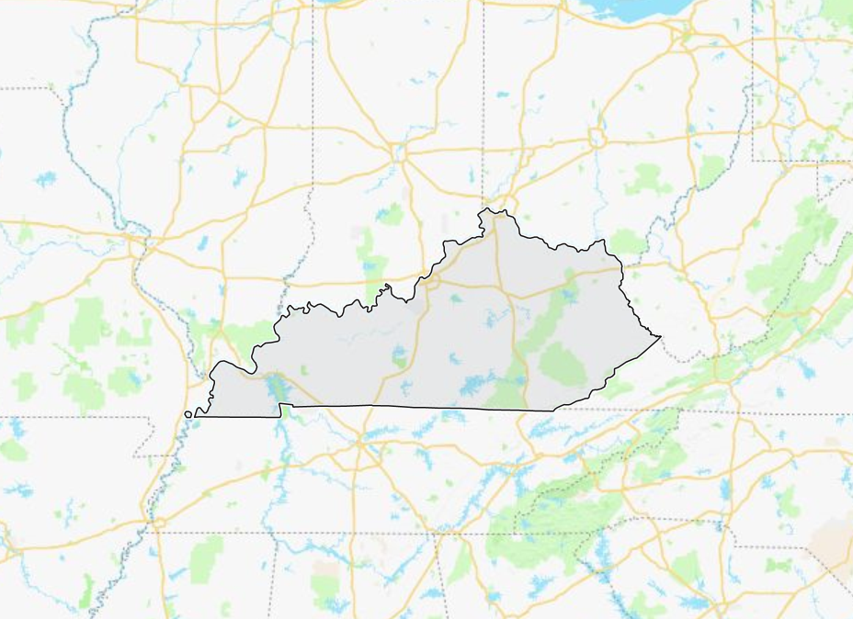
Kentucky The Bluegrass State
You are here:
Approx. 19,000 licensed attorneys
Clients’ Security Fund established in 1984
Here’s what’s
happening:

Slide 11
Maine The Pine Tree State
Approx. 5,000 licensed attorneys
Lawyers’ Fund for Client Protection established in 1997
Here’s what’s
happening:

Slide 12
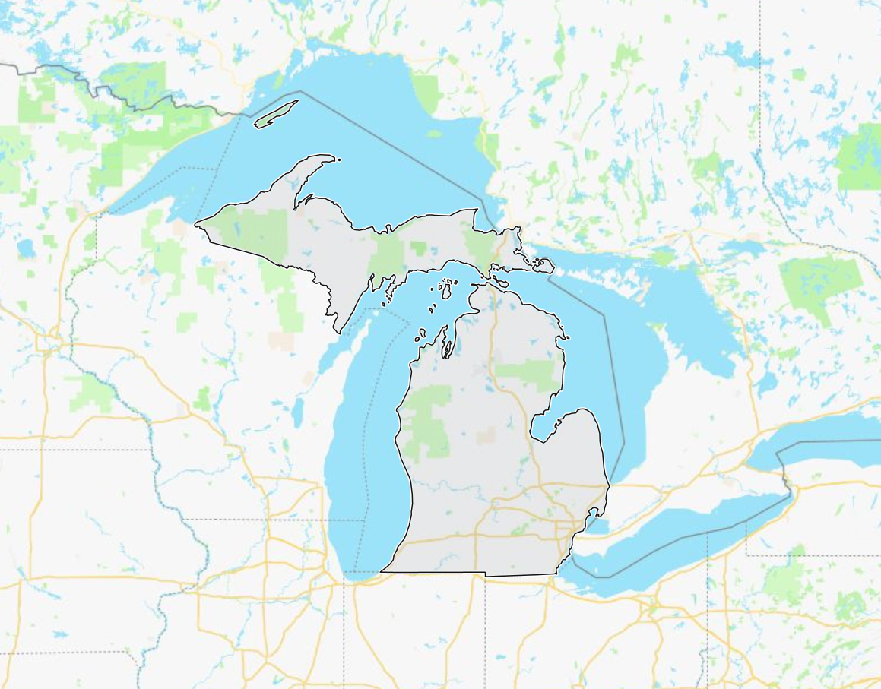
Michigan The Great Lakes State
Approx. 46,000 licensed attorneys
Client Protection Fund established in 1966
Here’s what’s
happening:

Slide 13
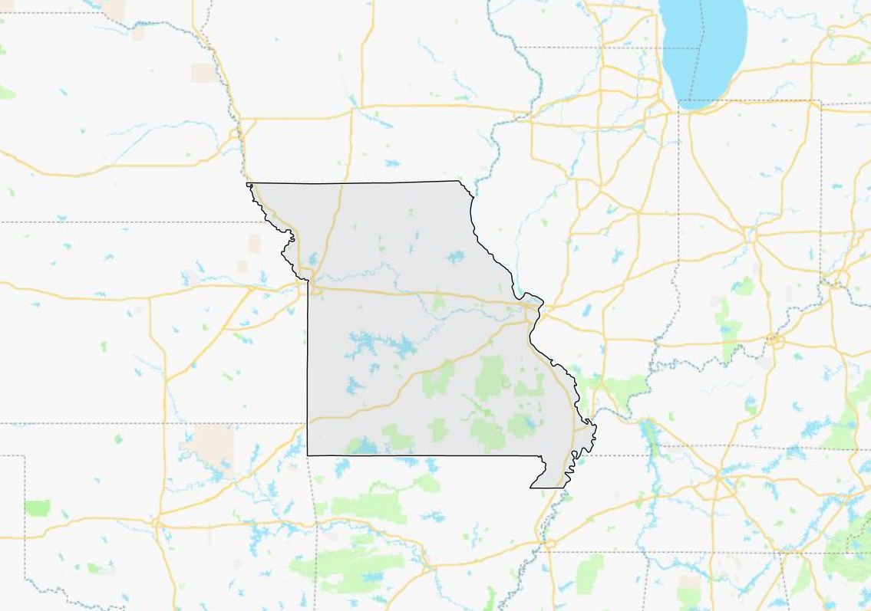
Missouri The Show Me State
Approx. 30,000 licensed attorneys
Client Security Fund established in 1966
Here’s what’s
happening:

Slide 14
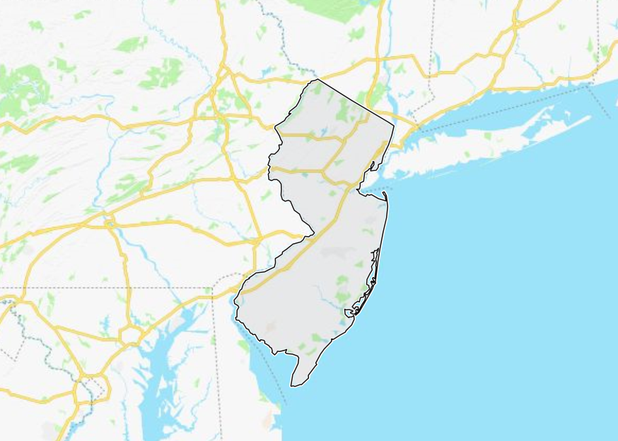
New Jersey The Garden State
Approx. 74,000 licensed attorneys
Lawyers’ Fund for Client Protection established in 1969
Here’s what’s
happening:

Slide 15
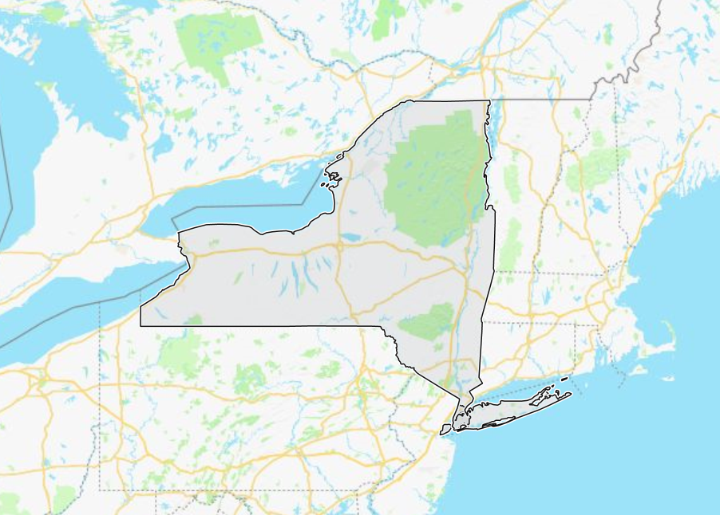
New York The Empire State
Approx. 325,000 licensed attorneys
Lawyers’ Fund for Client Protection established in 1981
Here’s what’s
happening:

Slide 16
Ohio The Buckeye State
Approx. 38,000 licensed attorneys
Lawyers’ Fund for Client Protection established in 1985
Here’s what’s
happening:

Slide 17
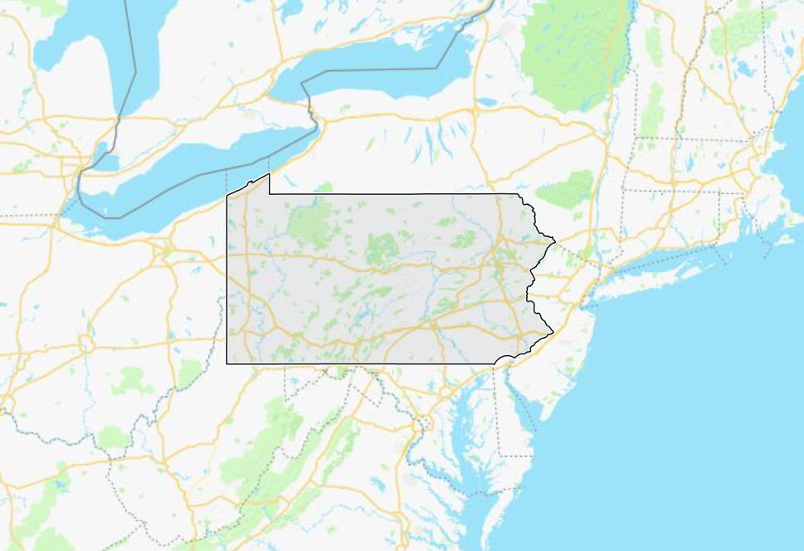
Pennsylvania The Keystone State
Approx. 75,000 licensed attorneys
Lawyers Fund for Client Security established in 1982
Here’s what’s
happening:

Slide 18
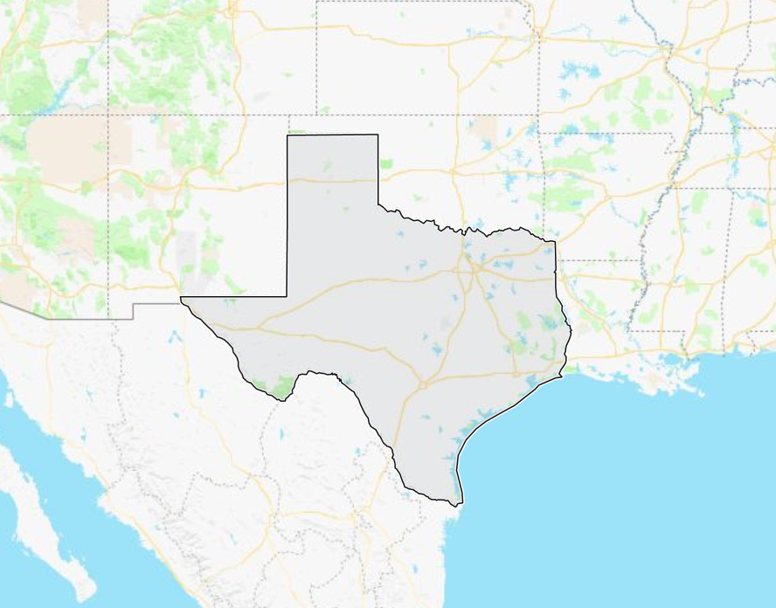
Texas The Lone Star State
Approx. 102,000 licensed attorneys
Client Security Fund established in 1975
Here’s what’s
happening:

Slide 19
Virginia The Old Dominion State
Approx. 24,000 licensed attorneys
Clients’ Protection Fund established in 1976
Here’s what’s
happening:

Slide 20
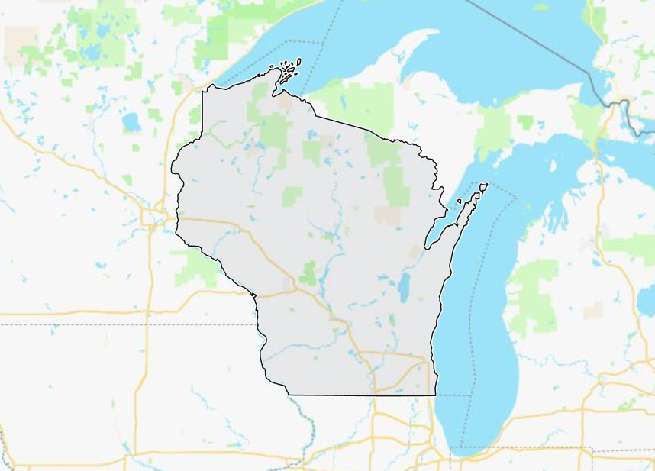
Wisconson The Badger State
Approx. 25,000 licensed attorneys
Clients’ Security Fund established in 1981
Here’s what’s
happening:

Slide 21
DID WE MISS ANYONE?

Slide 22
ANY MORE COMMENTS?

