Slide 1

Streams to Success
Exploring Alternative Revenue
Sources for Your Fund
Presented by:
Ashleigh Bailey, Deputy Bar Counsel
Jane H. Herrick, Chief Bar Counsel
Office of Bar Counsel
Kentucky Bar Association
Michael J. Knight, Sr.
Executive Director
NYS Lawyers’ Fund for
Client Protection

Slide 2

Egon: Don’t cross the streams.
Peter: Why?
Egon: It would be bad.
Peter: I’m fuzzy on the whole good/bad thing. What do you mean “bad”?
Egon: Try to imagine all life as you know it stopping instantaneously and every molecule in your body exploding at the speed of light.
Raymond: Total protonic reversal.
Peter: That’s bad. Okay. Alright, important safety tip, thanks Egon.
We all remember this good advice:
But in Client Protection – It’s OK to cross the streams!

Slide 3

ABA Model Rules for Lawyers’ Funds for Client Protection
RULE 3. FUNDING
A. The Court shall provide for funding by the lawyers admitted and licensed to practice law in the jurisdiction in amounts adequate for the proper payment of claims and the costs of administering the Fund.
Comment
[1] Paragraph A suggests that the single most important factor in establishing and maintaining an effective client reimbursement program is ensuring adequate and continuous funding through a reliable source. The Court, pursuant to its power to regulate lawyers and the practice of law, has the power to impose a fee to support the regulatory system. In the exercise of its authority, the Court may assess lawyers an annual fee to finance systems that implement the Court’s regulatory authority.
NCPO Standards for Evaluating Client Protection Funds
2.1 The Fund must have a source of income that is steady, secure and adequate to meet its standards of accessibility and responsiveness.
Commentary
Client protection is a field in which good intentions are not enough. A Fund in hiding or unable to meet the need cannot be considered a Fund at all. In many ways, funding is the ultimate Fund issue. Not only must funding be adequate, but it must be steady - every year or every other year - and secure. Given the Fund's importance to maintaining trust and respect within the legal profession, it cannot be permitted to go begging each year with clients' financial viability hanging in the balance.

Slide 4


Standard/Traditional Revenue Streams
Nearly All Client Protection Funds Receive Income From:
Annual Assessment/Registration Fees/Budget Appropriation
Restitution/Litigation
Investments/Interest Income
These sources, however may not be sufficient alone to provide meaningful reimbursement to victims.

Slide 5

Pros and Cons of Alternative Revenue Streams
Passive income – no heavy lifting.
Provides statutory framework to assist attorneys with Trust Account reconciliation (Missing Client/Deceased Atty).
May provide relief from rigid dependence on finite, traditional or erratic funding limits.
Public policy served with opportunity to deliver more meaningful client protection to law client victims.
May permit your Fund to avoid requesting additional assessments/appropriations.
Income stream(s) are not consistent.
May require development of additional oversight/monitoring protocols
Unable to budget for passive income.
Pros outweigh the Cons

Slide 6

Judicial Sanctions

Slide 7
Judicial Sanctions – NY History
December 1986 –
Decision: AG Ship Maintenance Corp. v. Lezak , 69 N.Y.2d 1 (1986)
“..there was neither a statute nor a court rule authorizing the imposition of sanctions for frivolous actions…” by lawyers.
June 1987 – NY Chief Administrative Judge proposed adoption of Court rules for imposing costs/sanctions against lawyers for frivolous conduct.
January 1988 – Administrative Board adopted Rule 130.1 and Rule 130.2 with the effective date of 01/01/88.

Slide 8

Rule 130-1.1 – Costs; sanctions
(a) The court, in its discretion, may award to any party or attorney in any civil action or proceeding before the court, except where prohibited by law, costs in the form of reimbursement for actual expenses reasonably incurred and reasonable attorney's fees, resulting from frivolous conduct as defined in this Part. In addition to or in lieu of awarding costs, the court, in its discretion may impose financial sanctions upon any party or attorney in a civil action or proceeding who engages in frivolous conduct as defined in this Part, which shall be payable as provided in section 130-1.3 of this Part. This Part shall not apply to town or village courts, to proceedings in a small claims part of any court, or to proceedings in the Family Court commenced under Article 3, 7 or 8 of the Family Court Act.
(b) The court, as appropriate, may make such award of costs or impose such financial sanctions against either an attorney or a party to the litigation or against both. Where the award or sanction is against an attorney, it may be against the attorney personally or upon a partnership, firm, corporation, government agency, prosecutor's office, legal aid society or public defender's office with which the attorney is associated and that has appeared as attorney of record. The award or sanctions may be imposed upon any attorney appearing in the action or upon a partnership, firm or corporation with which the attorney is associated.
(c) For purposes of this Part, conduct is frivolous if:
(1) it is completely without merit in law and cannot be supported by a reasonable argument for an extension, modification or reversal of existing law;
(2) it is undertaken primarily to delay or prolong the resolution of the litigation, or to harass or maliciously injure another; or
(3) it asserts material factual statements that are false.
Frivolous conduct shall include the making of a frivolous motion for costs or sanctions under this section. In determining whether the conduct undertaken was frivolous, the court shall consider, among other issues the (1) circumstances under which the conduct took place, including the time available for investigating the legal or factual basis of the conduct; and (2) whether or not the conduct was continued when its lack of legal or factual basis was apparent, should have been apparent, or was brought to the attention of counsel or the party.
(d) An award of costs or the imposition of sanctions may be made either upon motion in compliance with CPLR 2214 or 2215 or upon the court's own initiative, after a reasonable opportunity to be heard. The form of the hearing shall depend upon the nature of the conduct and the circumstances of the case.
Court, in its discretion, may impose sanctions on any party.
Rule defines what is considered frivolous conduct.

Slide 9
Rule 130-1.2 – Frivolous Conduct
Maximum sanction is $10,000 per occurrence.
Section 130-1.2 Order awarding costs or imposing sanctions.
The court may award costs or impose sanctions or both only upon a written decision setting forth the conduct on which the award or imposition is based, the reasons why the court found the conduct to be frivolous, and the reasons why the court found the amount awarded or imposed to be appropriate. An award of costs or the imposition of sanctions or both shall be entered as a judgment of the court. In no event shall the amount of sanctions imposed exceed $10,000 for any single occurrence of frivolous conduct.
Payments of sanctions by an attorney shall be deposited with the Lawyers' Fund for Client Protection established pursuant to section 97-t of the State Finance Law. Payments of sanctions by a party who is not an attorney shall be deposited with the clerk of the court for transmittal to the Commissioner of Taxation and Finance. The court shall give notice to the Lawyers' Fund of awards of sanctions payable to the fund by sending a copy of the order awarding sanctions, or by sending other appropriate notice, to the Lawyers' Fund for Client Protection, 119 Washington Avenue, Albany, NY 12210.
Sanctions imposed against attorneys shall be deposited with the Lawyers’ Fund for Client Protection.*
*Sanctions imposed against parties/litigants are payable to the Commission of Tax and Finance.

Slide 10

Rule 130-2 – Failure to Appear
Maximum sanction is $2,500 per occurrence.
Section 130-2 Order awarding costs or imposing sanctions.
Notwithstanding and in addition to the provisions of Subpart 130-1 of this Part, the court, in its discretion, may impose financial sanctions or, in addition to or in lieu of imposing sanctions, may award costs in the form of reimbursement for actual expenses reasonably incurred and reasonable attorney's fees, upon any attorney who, without good cause, fails to appear at a time and place scheduled for an action or proceeding to be heard before a designated court. This Part shall not apply to town or village courts or to proceedings in a small claims part of any court.
The court may impose sanctions or award costs or both only upon a written memorandum decision or statement on the record setting forth the conduct on which the award or imposition is based and the reasons why the court found the attorney's failure to appear at a scheduled court appearance to be without good cause. The imposition of sanctions or an award of costs or both shall be entered as a judgment of the court. In no event shall the total amount of sanctions imposed and costs awarded exceed $2,500 for any single failure to appear at a scheduled court appearance.
Payments of sanctions shall be deposited with the Lawyers' Fund for Client Protection established pursuant to section 97-t of the State Finance Law.

Slide 11

NY St. Fin. Law 97-7 (2). The full amount of the allocable portion of the biennial registration fee collected pursuant to the provisions of section four hundred sixty-eight-a of the judiciary law and such other monies as may be credited or otherwise transferred from any other fund or source, pursuant to law, including voluntary contributions, together with any interest accrued thereon, shall be deposited to the credit of the lawyers' fund for client protection of the state of New York.
In 1990, the Fund survived a challenge by the NY State Comptroller which questioned the our legal authority to accept these payment. We successfully argued that our enabling statute, NY Fin. Law 97-t, permitted the Fund to collect monies ”…as may be credited or otherwise transferred from any other fund or source, pursuant to law,…”
The legal argument was that the term ‘pursuant to law’ extended beyond statutory law and included other dictates having the force of law, including the Rules of the Chief Administrative Judge. This reasoning will be relevant in our discussion of missing client funds.

Slide 12

Judicial Sanctions - Mechanics
Fund receives a copy of the sanction order.
Acknowledges receipt of sanction payment to
attorney and Court.
Sanction payments are deposited to the Fund’s Special Revenue Account with restitution receipts.

Slide 13
Judicial Sanctions – Collection Protocol
If Non-Payment:
Write attorney/firm re: non-payment; copy to Court.
Deferral if on appeal.
Demand if no appeal or appeal dismissed; copy to Court.
Final demand with threat of referral.
Enforcement/Discipline for Non-Compliance
- Attorney Grievance Committee Referral.
- Attorney General Collection Referral.
- Copy of referrals to the Court issuing sanction.

Slide 14
Judicial Sanctions - Results
The Fund’s other sources of revenue include restitution, interest, judicial sanctions, contributions and unclaimed escrow deposits of missing clients and deceased attorneys held by the Fund for over five years pursuant to court rules. Since 1982, the Fund has received $229 million from attorney registration fees; $23 million in restitution; $5.8 million in interest income; $3.9 million in judicial sanction revenue; and $319,000 in contributions from lawyers and the public. The Fund’s revenues are annually appropriated to the Fund by the State Legislature as part of the Judiciary Budget.
Source: 2021 NY Lawyers’ Fund Annual Report

Slide 15


Pro Hac Vice Registration
By Supreme Court order, the Client Security Fund receives $7 per year, per attorney from the KBA dues.
Bar Counsel had been seeking alternative revenue sources in an attempt to funnel more money into the Fund reserves besides increasing dues.
  One Trustee reached out to a Supreme Court Justice regarding concerns about low funds in the reserves and what we could do to get more money and Pro Hac Vice fees were considered.
  The Executive Director of the KBA enlisted Bar Counsel to compile history and data regarding KY’s Pro Hac Vice rule in an effort to utilize those fees for CSF.
During this time, The Courier Journal, one of the two largest newspapers in Kentucky, wrote an article titled, “Lawyer rip you off? You may get back only pennies on the dollar from the Kentucky bar” following two catastrophic cases involving attorneys who maxed their caps out, and the large amount of claimants received prorated awards.

Slide 16

Pro Hac Vice Registration
In addition, the Accountant for the KBA compiled a revenue history from Pro Hac Vice fees since 2014 to present
OBC reviewed the ABA Survey re: pro hac fees and found the following:
  Of the 36 states/territories (including Washington D.C.) who charge an annual fee, Kentucky ranked approximately 12th highest, charging a fee equal to what a Kentucky lawyer admitted for at least 5 years is charged. At that time, that fee was $310.00. The highest annual fee was Arkansas, with $660.00. The lowest annual fee was $100.00 in Washington, D.C., Kansas, and Missouri.
  Nine (9) states charged a fee per case, ranging from $50.00 in California to $550.00 in Nevada. Six (6) states either did not charge a fee or did not specify a fee amount in their Rules.
  Notably, a couple of states incorporated a Clients’ Security Fund allotment or fee into their Pro Hac Vice Rule. Connecticut, which charged a $620 fee, gave $565.00 to the Department of Revenue, and $75.00 to the Clients’ Security Fund. Washington charged a $250.00 fee and an assessment for the client’s protection fund. Pennsylvania gave the proceeds of their $350.00 fee to the IOLTA Program. Utah provided attorney discipline with the $250.00 fee, and North Dakota gave $75.00 of their $200.00-385.00 fee to attorney discipline as well.

Slide 17

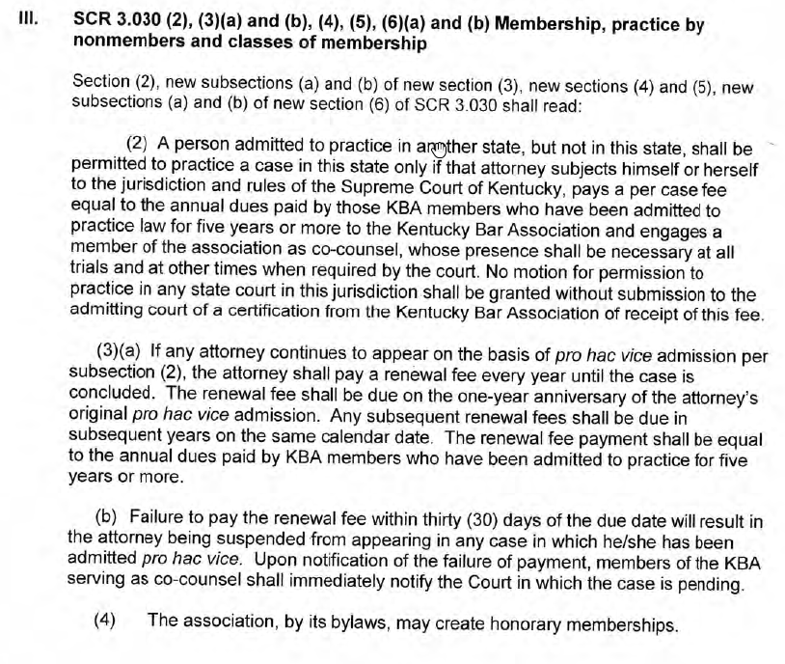
The old SCR 3.030 effective until January 1, 2005 had no fee requirement for someone to be admitted pro hac vice. The timeline of the pro hac vice rule in KY was as follows:
  January 1, 2005- Fee of $100.00 per case was added.
  March 1, 2012- Fee was increased to $270.00 per case.
  January 1, 2016- Fee was changed to “a one time per case fee equal to the annual dues paid by those KBA members who have been admitted for five years or more…”
  2019- A proposal was made to amend the rule to omit “one time” and instead the attorney pays the fee equal to the annual dues of a member admitted for five years or more, but now has to pay a renewal fee every year until the case is concluded. The fee is due on the one year anniversary of the attorney’s pro hac vice admission. Any subsequent renewal fees shall be due in subsequent years on the same calendar date. The renewal fee is equal to the annual dues paid by members who have been admitted for five years or more.

Slide 18

Pro Hac Vice Registration
Executive Director then presented the timeline of the pro hac vice rule, the chart re: what other jurisdictions charge for pro hac vice (from the 2016 ABA Survey) and a summary explaining caps in other jurisdiction to the KY Supreme Court.
Rule was amended by Order of the KY Supreme Court in March 2020.
  Request from Clients’ Security Fund Trustees - Pro Hac Renewal Fees – At the next Board of Governors meeting, the Executive Director reported that the Clients’ Security Fund reserves were low. He indicated that annually the funds from the pro hac renewals go to the general fund. The Clients’ Security Fund balance was approximately $600,000 and the Clients’ Security Fund Trustees wanted it to be closer to $1,000,000. He indicated that the Clients’ Security Fund Trustees were requesting the Board to allow the funds from the pro hac renewals be deposited in the Clients’ Security Fund reserves verses the general fund for the current year’s receipts. After discussion, one Board member moved to approve the Clients’ Security Fund Trustees’ request to deposit the pro hac renewal funds this year into the Clients’ Security Fund. Another Board member seconded, and the motion was unanimously APPROVED.

Slide 19

Pro Hac Vice Registration
Clients’ Security Fund Reference Materials
1. SCR 3.820 Clients’ Security Fund
2. Kentucky Supreme Court Order regarding Claim Limits
3. Kentucky Supreme Court Order regarding KBA Annual Dues Structure
4. Clients’ Security Fund Redacted Annual Report, 2017-2018 Fiscal Year
5. Clients’ Security Fund Balance History Chart, 1997 – 2018
6. Total Claims Received FYE 2009 – 2018
7. Total Amounts Awarded FYE 2009 – 2018
8. Total Claims Meeting Claim Limits by Attorney and by Claimant
9. 2014 – 2016 Survey of Lawyers’ Fund for Client Protection Summary and Report
10. Courier Journal Article published February 25, 2019 regarding CSF

Slide 20

Unclaimed/Missing Client Funds

Slide 21

Missing Client/Deceased Attorney Escrow
Abandoned Property Laws - know your State.
Voluntary Disposition of Abandoned Property
NY Legislative History - 1994
NYS OSC Opinion (1995)
Applies in the absence of another statute/rule.
Mechanics
Copy of rules (22 NYCRR Rule1.15(f),(g))
Policy on deposits under $1,000.
Sample Pleadings – www.nylawfund.org
Costs can be recovered from the Escrow.
Safe Harbor Rule
De minimis Deceased Attorney Deposits - Letter

Slide 22
Review Your State’s APL

Slide 23
In 1995, the NYS Comptroller’s Office provided an opinion letter which determined that Court rules, not the Abandoned Property Law, governed the disposition of unclaimed funds in attorney trust accounts.

Slide 25
In 2017:
7200.4 Powers of trustees. In the exercise of the authority granted the trustees, the trustees have the power to:
(a) receive, hold, manage and distribute 50 per centum of the monies collected pursuant to the provisions of section 468-a of the Judiciary Law and such other monies as may be credited or otherwise transferred from any other fund or source, pursuant to law, including voluntary contributions together with any interest accrued thereon. All deposits of such revenues not otherwise required for the payment of claims shall be secured and invested as required by the provisions of section 97-t of the State Finance Law. For purposes of this subdivision, monies "transferred from any other fund or source" shall include monies paid to the Lawyers' Fund for Client Protection pursuant to Rules 1.15 (f) and 1.15 (g) of the Rules of Professional Conduct (22 NYCRR Part 1200), including earned interest, except that such monies shall not be available for use by the Lawyers' Fund unless the Fund is unable to ascertain the identify of the person or persons entitled to such monies or, during the five years following payment of such monies to the Fund, the Fund has been unable to locate that person or persons, and no valid claim has otherwise been made upon such monies. The Lawyers' Fund's use of such monies shall not extinguish a future valid claim to such monies by persons entitled thereto;

Slide 26
Missing Client/Deceased Attorney Escrow
Intake Protocol
Deposited in SEPARATE interest-bearing trust account.
Separate from the Fund’s reimbursement program.
Each deposit is acknowledged/recorded in a unique database.
Search Protocol
We request last known address or other information on the beneficial owner.
We use national databases to attempt to locate owner(s).
We will write to beneficial owner with instructions on how to request a refund.
Refund Protocol
Require proof of identification/Court order.
Refund memorandum prepared.
Check prepared and recorded with file.
Sweep Protocol (Every 2 Years)
NY Fund 2017 Regulation Amendment
Quarterly reports to Trustees on balance/available balance.
Over 5 Years
Unknown Deposits
Accrued Interest Income

Slide 27
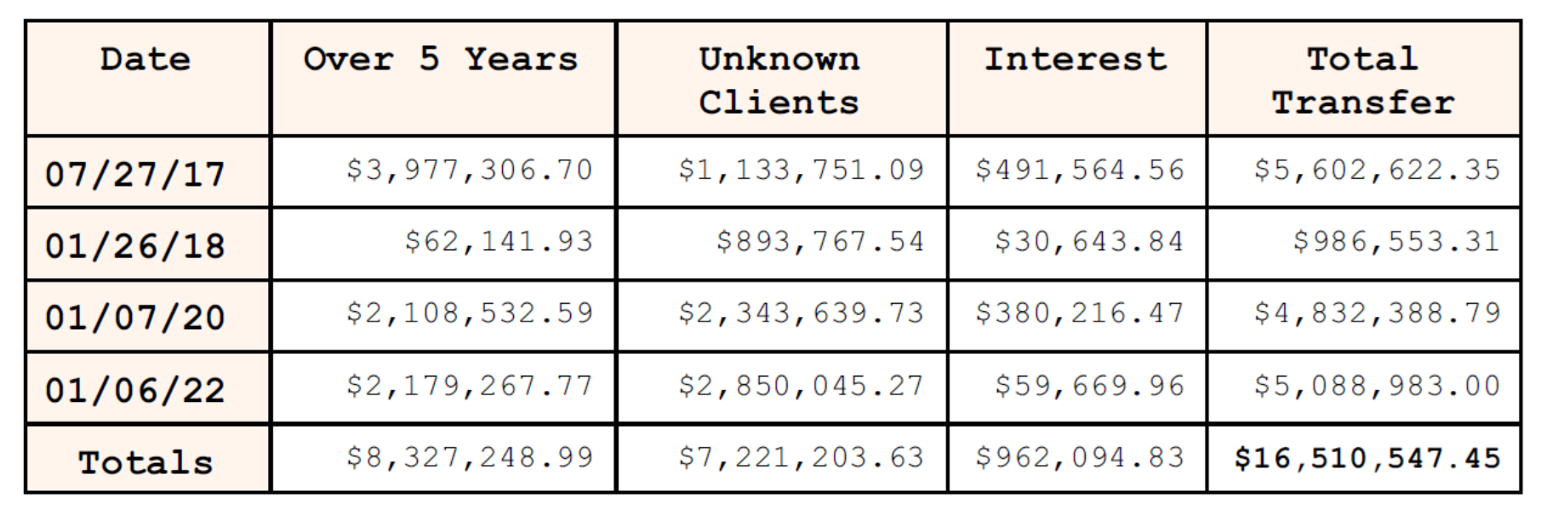
Results:
Since 1994, the Lawyers’ Fund has restored nearly $2 million to over 700 missing clients.
Since 2017, the Lawyers’ Fund has made use of over $16.5 million for the benefit of law client reimbursement awards.

