Slide 1
The Why, Who, What and How of Building a Trust Account Program
Robbie Clements
Administrative Manager/ Deputy Bar Counsel
Kentucky Office of Bar Counsel
NCPO Fall Workshop 2022

Slide 2
Why start a Trust Account Program?
Diversion
Discipline
Prevention
Notes:
So when we began looking at the possibility of starting a trust account program in KY, we had 3 main purposes in mind –
Diversion – the program could be used as our EPEP had been, in connection with conditional dismissals, for minor ethical issues that did not rise to the level of requiring some kind of discipline. Failure to timely submit an accounting when requested perhaps.
Discipline – in connection with a conditional private admonition or public reprimand, or as a condition of a probated suspension.

Slide 3
Diversion
Address conduct that doesn’t rise to the level of formal discipline
Agreement to attend and complete to avoid further disciplinary action
This Photo by Unknown Author is licensed under CC BY-SA-NC

Slide 4
Discipline
Condition of private admonition
Part of probation
Impact on recidivism

Slide 5
Prevention
Response to trust account overdrafts
Result of trust account audits
In connection with PMBR
Supplement to existing ethics programs
This Photo by Unknown Author is licensed under CC BY-SA

Slide 6
Who is the target audience?
Invitation only v. Open to all
Non-lawyer staff
New lawyers

Slide 7
Invitation only v. Open to all
Require respondents to be directed or ordered to attend
Allow any attorney to attend
Protection of confidentiality
CLE credit available or not?

Slide 8
Non-lawyer staff
Requirement to attend with an attorney
Program for non-lawyer staff only?
This Photo by Unknown Author is licensed under CC BY

Slide 9
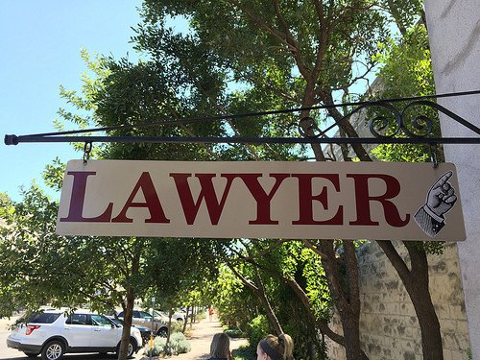
New lawyers
Supplement to existing new lawyer program
Requirement to attend before beginning practice
Attorneys new to private practice
This Photo by Unknown Author is licensed under CC BY

Slide 10
What should be covered?
Text of Rule 1.15
Cases and ethics opinions
Best practices
Hands-on exercise

Slide 11
Include all trust account rules
Very jurisdiction-specific
Break down all rules related to trust accounts
Include discussion of the Comments
Outline all expectations
Assume nothing
This Photo by Unknown Author is licensed under CC BY-SA

Slide 12
Best practices
Is this giving advice?
Use of hypotheticals
Getting attendees involved
This Photo by Unknown Author is licensed under CC BY-SA

Slide 13
Hands-on exercise
Checkbook/general ledger balance
Adjusted bank balance
Client ledger balances
Most effective approach?
Establishing new clients
Handling basic transactions
Three-way reconciliation

Slide 14
Details, details…
How often do we present?
How much should it cost?
Who are the presenters?
How do we get the word out?

Slide 15
How do we get the word out?
Notification to those who overdraw IOLTA accounts
Articles in bar magazines
Mini-versions as CLE presentations
Materials available on websites

Slide 16
Who are the presenters?
Disciplinary staff
Outside accountants
Ethics committee members
Other outside speakers
This Photo by Unknown Author is licensed under CC BY-NC-ND

Slide 17
How often do we present?
Based on number of attendees
One or multiple times per year
One or multiple locations
Recorded program available
This Photo by Unknown Author is licensed under CC BY-NC

Slide 18
How much should it cost?
Consider location
How long is the program?
Outside speakers?
Snacks provided?
This Photo by Unknown Author is licensed under CC BY-NC

Slide 19
Questions?

