Slide 1

National Client Protection Organization
Outreach Programs & Initiatives

Slide 2

2023
NCPO was founded in May 1998.

Slide 3
NCPO Standards For Evaluating
Client Protection Funds (2006)
Approved by the National Conference of Chief Justices.

Slide 4


Standards for Client Protection Funds

Slide 5

Fundamental Building Blocks
An organizational structure that secures the Fund’s independence
Steady, secure and adequate
funding
Accessibility
Responsiveness to Need

Slide 6
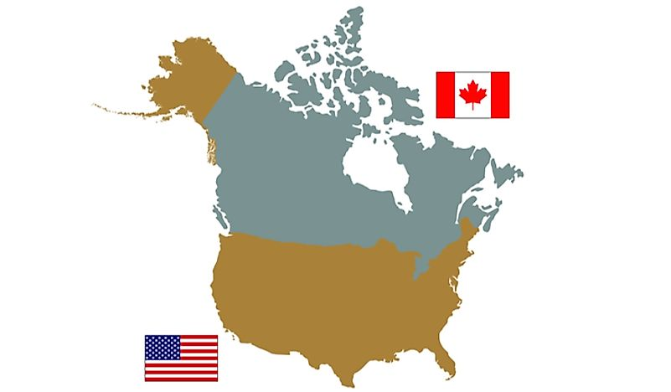
Membership

Slide 7

Iowa
2023
NCPO Workshop Assistance Program

Slide 8


Speakers’ Bureau
Need someone to talk about:
What is a client protection fund and what does it do?
Payee Notification?
Overdraft Notification?
The benefits of community education about your Fund?
What constitutes a high- performing client protection fund?

Slide 9

Education

Slide 10

Annual
Reports

Slide 11

Annual Survey

Slide 12

Grant Program

Slide 13
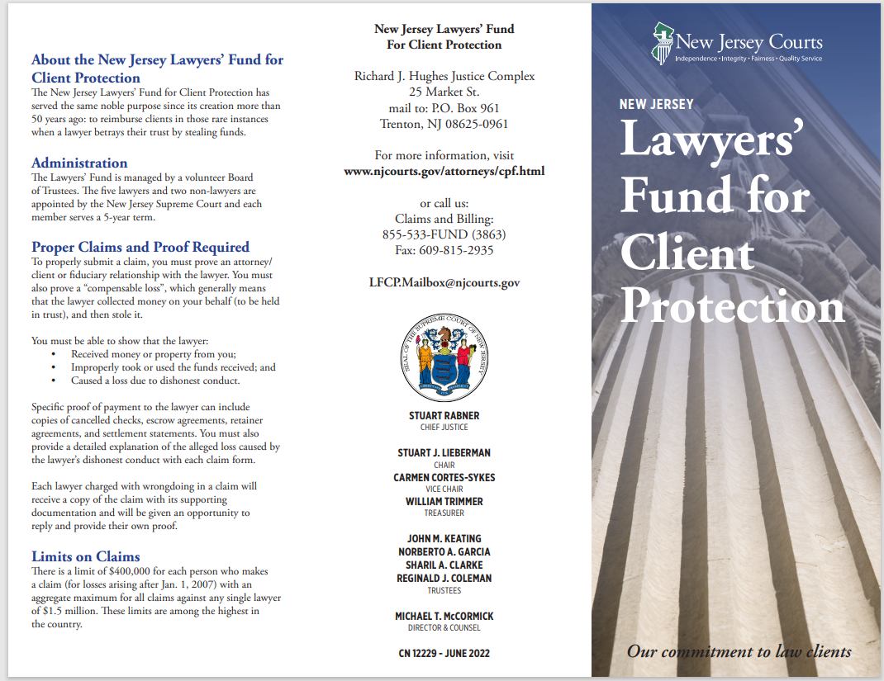
NEW JERSEY LAWYERS’ FUND FOR CLIENT PROTECTION BROCHURE

Slide 14
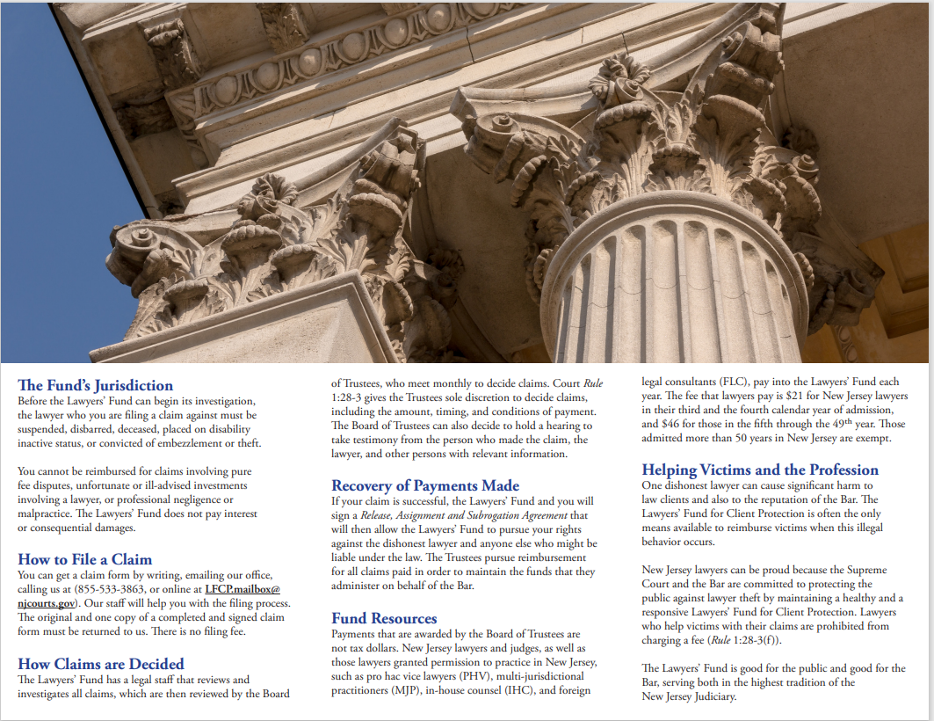

Slide 15
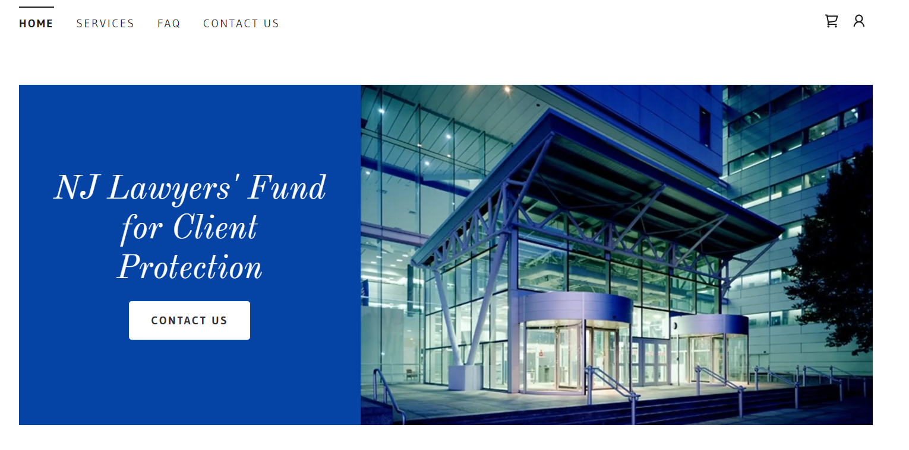
Webpage Development

Slide 16

NCPO Grant to the Maine Fund

Slide 17

Press Release

Slide 18

The Client Protection Webb

Slide 19

Contact Information
Michael T. McCormick, Esq.
Director & Counsel
NJ Lawyers’ Fund for Client Protection
(609) 815-3030, ext. 52215
Michael.mccormick@njcourts.gov

