Slide 1

Get your Money BacK
Collections Made Easy:
How to increase your Fund’s
subrogation receipts.

Slide 2
Douglas Burry, Senior Counsel
Ruby Cochran, Deputy Counsel
New Jersey Lawyers’ Fund
for Client Protection

Slide 4
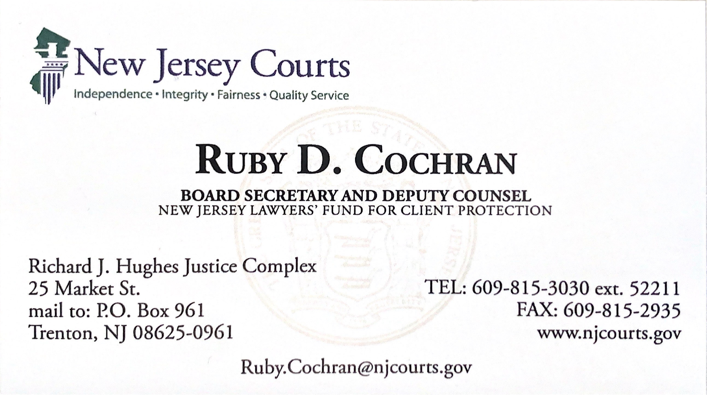

Slide 5
Topics we will cover
Things to do when processing the claim
Collecting from the respondent’s accounts and assets
Getting a judgment against the respondent
Suing third parties
Collecting from the respondent post-judgment
Preserving the judgment in Bankruptcy

Slide 6
Advantages of collection
Maintain fund’s financial integrity
  Avoid raising annual assessment
  Avoid requests for additional funds
Let respondents know there will be consequences
Let Supreme Court, other lawyers and public know that Fund cares about maintaining integrity of Bar
Try to maximize recoveries as efficiently as possible

Slide 7
Sources for collection efforts:
Collect from respondent’s accounts/assets
Obtain judgment against respondent
Sue other parties
Depending on circumstances, do one, two, or all three.
Collect from Respondent’s Accounts/Assets
Sue Other Parties
Obtain Judgment Against Respondent

Slide 8

respondent’s assets and accounts
Two main methods:
  Custodial Receiver
  Respondent’s Business and Trust Accounts

Slide 9
Custodial receivers
When an attorney is in violation of ethics rules concerning client funds, the Fund may request a custodial receiver
Receiver is Court appointed
Receiver’s duty is to marshal and preserve assets of offending attorney, even before claims are paid
Receiver can collect ARs, sell equipment, pursue fraudulent transfers, etc.
May be a good solution for more complex matters

Slide 10
Recoup from respondent’s accounts
NJ Fund gets jurisdiction only on suspension or disbarment
In NJ, accounts are frozen upon suspension or disbarment
  Usually transferred into Superior Court Trust Fund
  Transferring language is often in suspension Order [Ex. 1]
Court Trust Fund money is available for clients whose funds can be tracked directly back to them
The Fund can petition for the release of Court Trust Fund money to recuperate money paid out in awards

Slide 11
Recoup from respondent’s accounts
Funds not always transferred into court
Can happen especially if respondent was only suspended
Accounts are frozen in respondent’s bank
File motion for court to order release money to your Fund

Slide 12
Judgments against respondents
Get a Restitution Order against respondent if they are charged criminally
File a civil action against the respondent

Slide 13

Restitution order
When a respondent is charged criminally, stay in communication with the prosecuting authority.
Write a letter to the prosecutor summarizing claims paid and request that restitution be ordered. [Ex. 2]
Notify sentencing Judge, maybe appear at sentencing
Claimant will be most cooperative

Slide 14
Restitution order
Fund must be named as victim, not claimant
Restitution Order included in plea agreement and/or Judgment of Conviction [Ex. 3]
Restitution Order may be used for collection purposes and/or to place state-wide lien on assets
Probation department monitors and distributes payments during any period of probation – keep in touch
Restitution Order is exempt from BK. 11 USC 523(a)(7)

Slide 15
File suit against Respondent
Claim award requires subrogation and cooperation by claimant [Ex. 4]
File after all claims against respondent are resolved
Get assignment of any judgment claimant had

Slide 16
File suit against Respondent
Causes of Action vary – fact specific [Ex 5]:
  Breach of Contract
  Breach of Fiduciary Duty
  Conversion
  Civil Conspiracy
  Fraud
  Unjust Enrichment
  Breach of Implied Covenant of Good Faith and Fair Dealing

Slide 17
Other Considerations for suit
Prepare for difficult service
Serve Interrogatories with Complaint [Ex 6]
If claimant is in suit against respondent, monitor suit, approve settlement, possibly intervene
Respondent may have fee agreements from transferred cases

Slide 18
Other Considerations for suit
Collect and update information on possible assets
  On-line sources
Respondent may inherit
If respondent is deceased or passes away, may sue estate – communicate with Administrator/ Executor
County probate office may be good source
Consider filing OTSC if fraudulent transfer is possible

Slide 19
Other Considerations for suit
In unearned retainer case, Fee Arbitration decision may preclude defenses
Get Summary Judgment for defaults
  Due process implications
Track judgments and renew
Transfer judgments to other jurisdictions

Slide 20

Sue third parties
Respondent may be in worst position to pay
Consider suing other culpable parties
Garner facts from claimants and witnesses

Slide 21
Sue third parties
Possible parties include:
  Banks – e.g. forged endorsement
  Title Companies
  Law partner/firm – e.g. negligence
    Notice to malpractice carrier
  Entities connected to respondent
  Conspirators
  Insurers, bonding companies

Slide 22
General considerations
Respond to frivolous litigation – track hours
Utilize Offer of Judgment rule
Demand letters
Consider attorney fees, treble damages
  Consumer fraud
Bankruptcy implications

Slide 23
Collections and bankruptcy
Ruby Cochran, Deputy Counsel

